Slide 1
Celebal Project
Cloud-4

Slide 2
Project Group Details
Project Mentor
Team Details
Ms. Reema Rani
Assistant Professor
School of Computer Science and Engineering
Poornima University, Jaipur
Ekta Jarwal
Pallavi
Harneet
Gopal

Slide 3

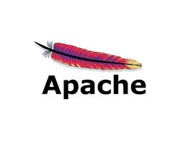
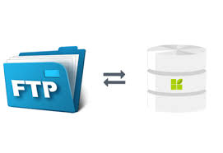
Objective….
To Configure FTP server in Azure Cloud using Terraform.
To Configure Apache server in Azure Cloud using Terraform.

Slide 4
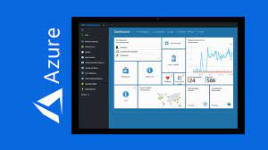
What’s New!!!
Infrastructure as Code
You describe your infrastructure using Terraform's high-level configuration language in human-readable, declarative configuration files. This allows you to create a blueprint that you can version, share, and reuse.

Slide 5
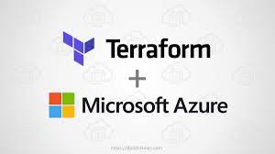
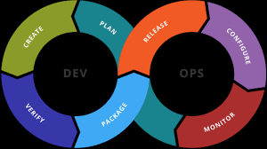
Target Audience
Cloud Domain Students :
It helps the cloud Domain Students to automate the task . To configure a large number of servers and machines in portal ,it will take more time . So , to efficiently do the same configuration in multiple servers we use terraform to automate our task.
DevOps Students :
As terraform is a Infrastructure as a code tool . It is used by the developers. DevOps is all about automation so, it will be good to learn about terraform for them.

Slide 6
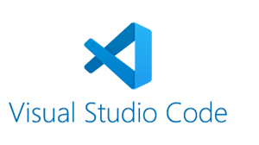
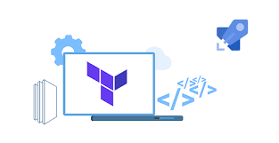
Technology Used
Terraform By hashiCorp
Azure Cloud Provider
Visual Studio Code

Slide 7

Technologies in Detail…
Terraform
Terraform is an infrastructure as code (IaC) tool that allows you to build, change, and version infrastructure safely and efficiently. This includes low-level components such as compute instances, storage, and networking, as well as high-level components such as DNS entries, SaaS features, etc.

Slide 8
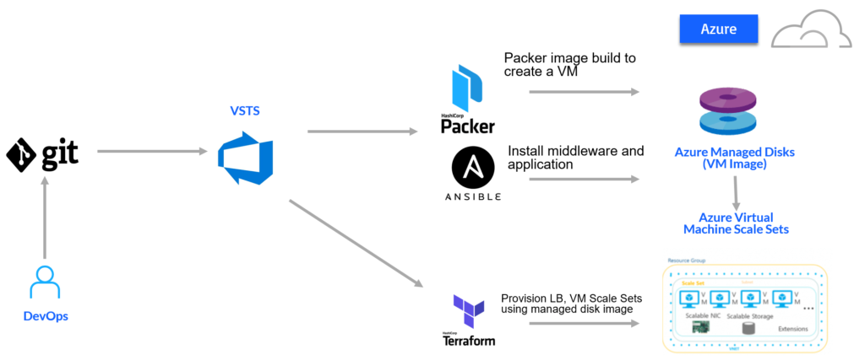
Why Terraform ???
Codify your application infrastructure
Reduce human error and increase automation by provisioning infrastructure as code.

Slide 9
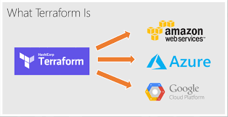
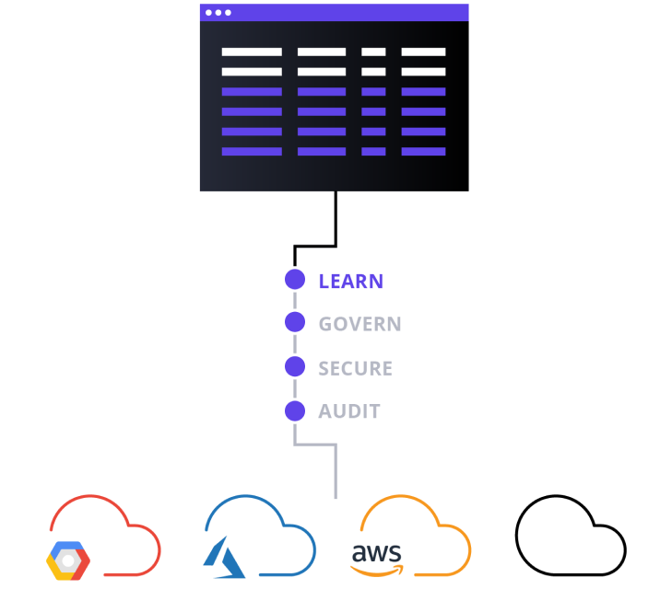
Manage infrastructure across clouds
Provision infrastructure across 300+ public clouds and services using a single workflow
Create reproducible infrastructure
Provision consistent testing, staging, and production environments
with the same configuration.

Slide 10
How Terraform Works
Terraform allows infrastructure to be expressed as code in a simple, human readable language called HCL (HashiCorp Configuration Language). It reads configuration files and provides an execution plan of changes, which can be reviewed for safety and then applied and provisioned.
Extensible providers allow Terraform to manage a broad range of resources, including IaaS, PaaS, SaaS, and hardware services.

Slide 11
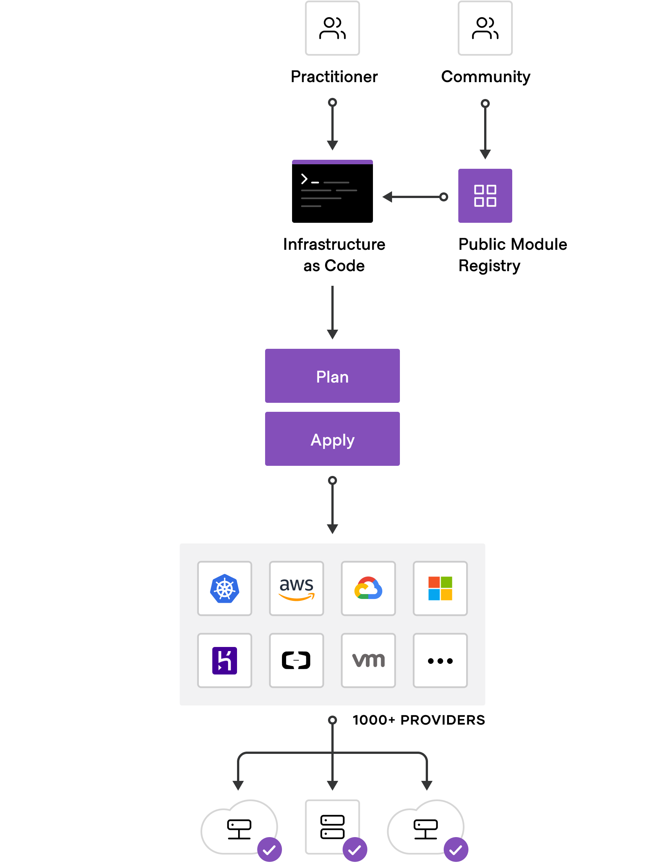

Slide 12
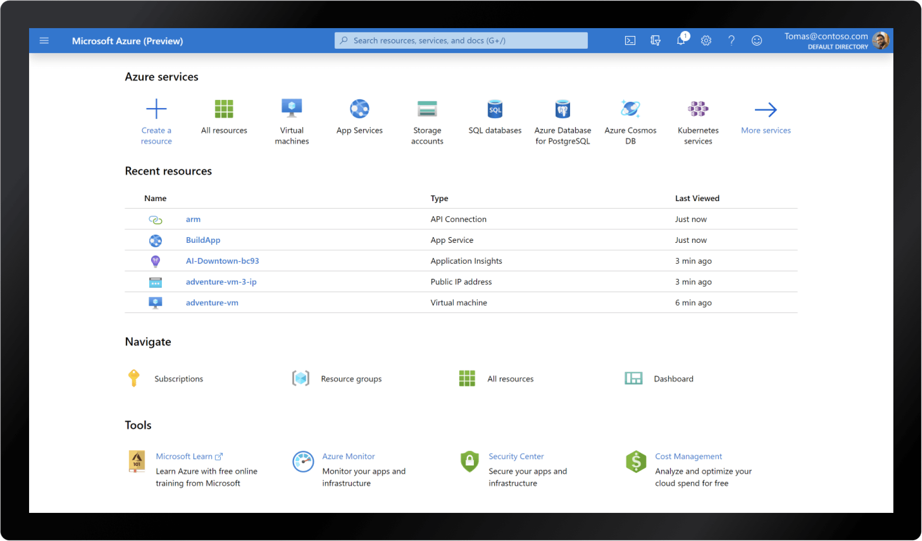
Brief About Azure Portal
The Azure portal is a web-based, unified console that provides an alternative to command-line tools. ... You can build, manage, and monitor everything from simple web apps to complex cloud deployments. Create custom dashboards for an organized view of resources.

Slide 13

Project Demonstration…

Slide 14
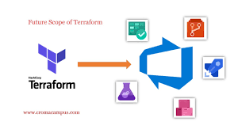
Future Scope
Terraform is used to manage the vast majority of our cloud infrastructure. We happen to primarily use AWS, Azure, however we are mindful that some components of our system may need to move to other cloud providers in the future, so the cross-platform abilities of Terraform are of particular relevance to us.
More than anything else, Terraform is the tool that we use to realize the "infrastructure as code" ideal throughout our organization.

Slide 15
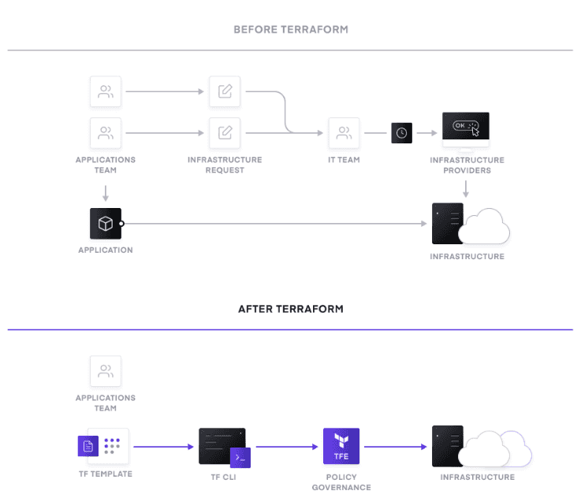
Conclusion…
In this presentation we
demonstrated :
We configured an Apache
server in azure cloud using
terraform.
We also configured a FTP server
in azure cloud using terraform.

Slide 16
THANK YOU

